Slide 1
ANALYSIS OF TRAVEL INSURANCE COMPANY DATA
Presenter:B.Shanmukhi

Slide 2
BUSINESS UNDERSTANDING
As the company had to cut down marketing budget by over 50% due to the pandemic the marketing strategy should be made that is advertised to the right set of people
The main strategy is to focus on the right set of people who could be potential customers
Two approaches have been made to identify the right set of people with no Insurance to advertise :
People who are Frequent Flyers and had travelled Abroad
People who are either Frequent Flyers or had travelled Abroad
By these approaches we go deep down into looking other attributes like Income, Family Members and Chronic Diseases in order to get the right set of people to be customers.

Slide 3
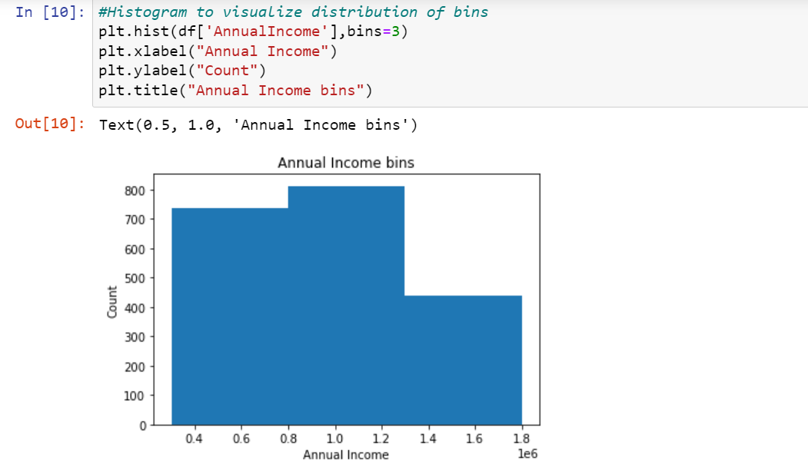
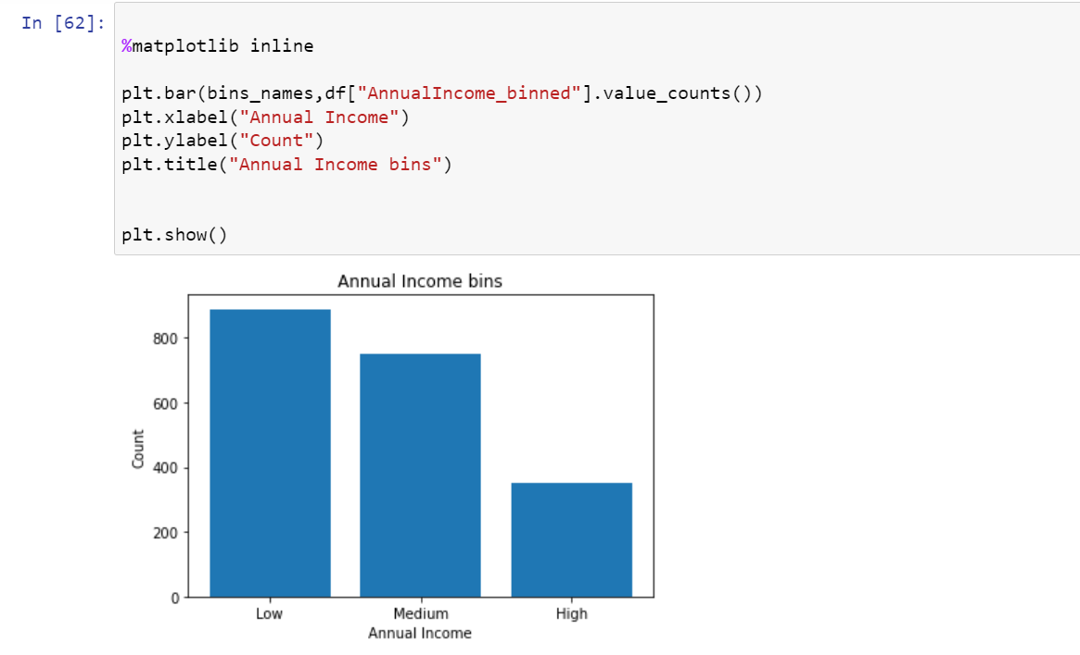
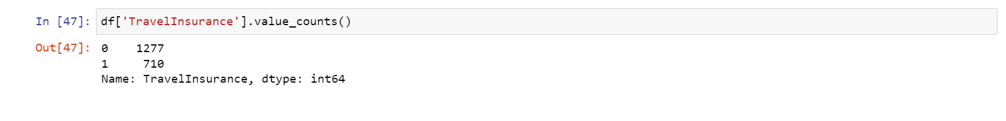
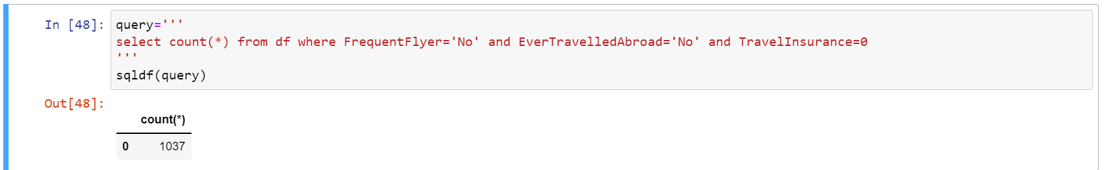
BASIC INSIGHTS

Slide 4
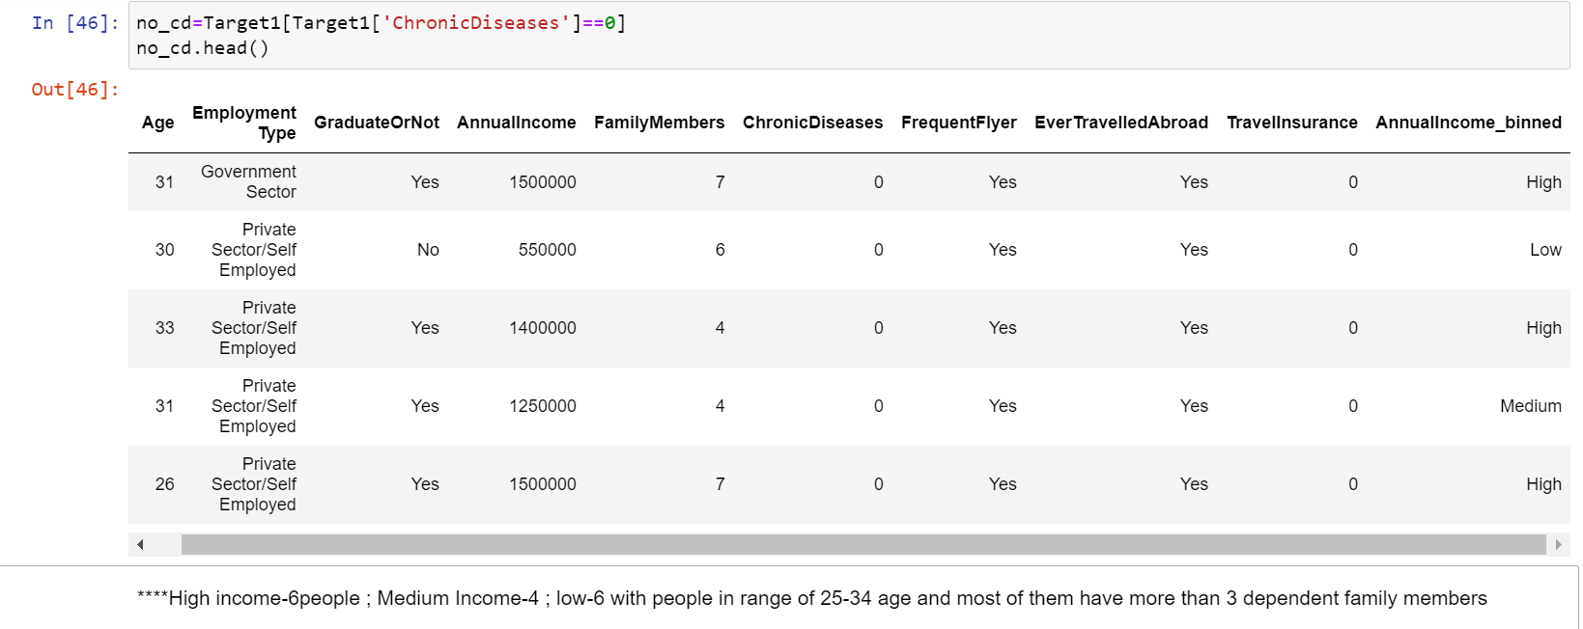
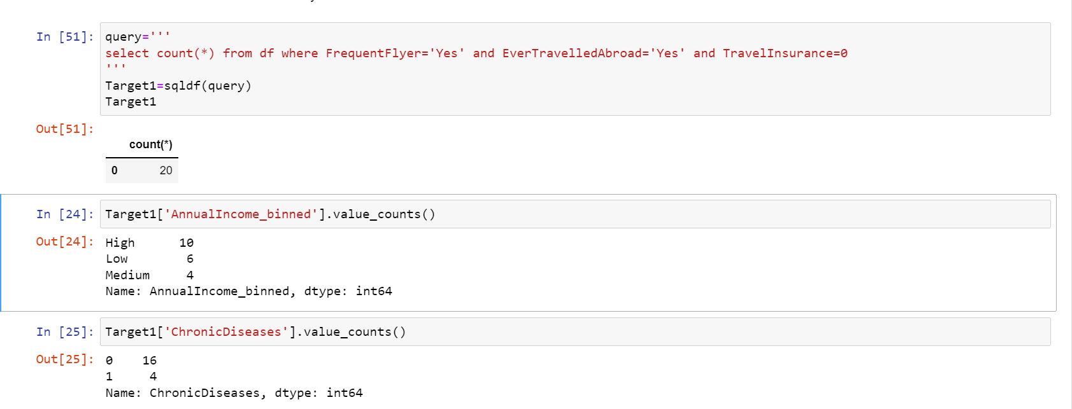
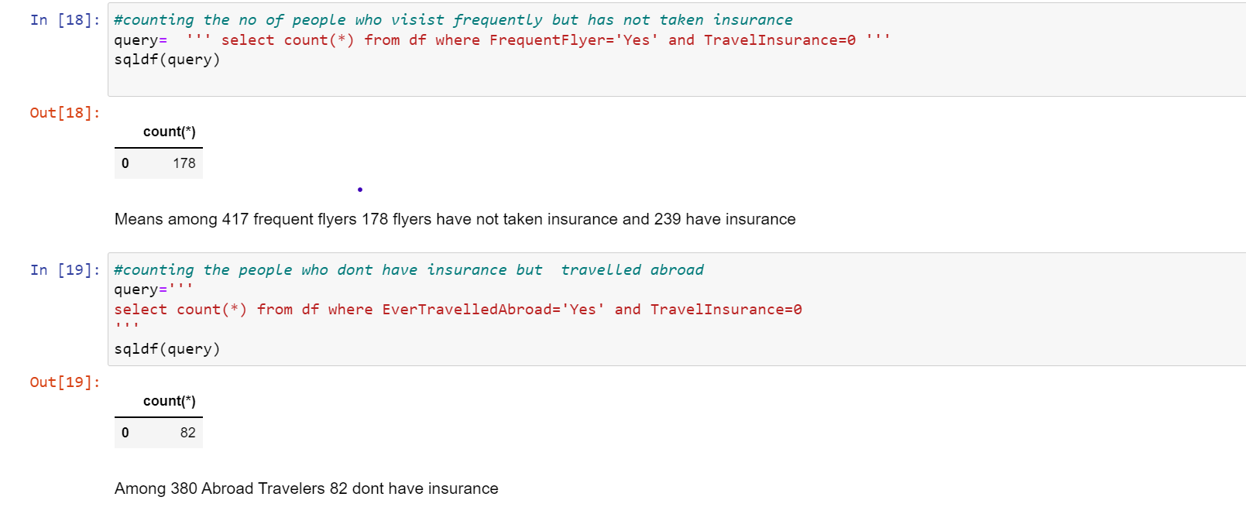
APPROACH:1 INSIGHTS

Slide 5
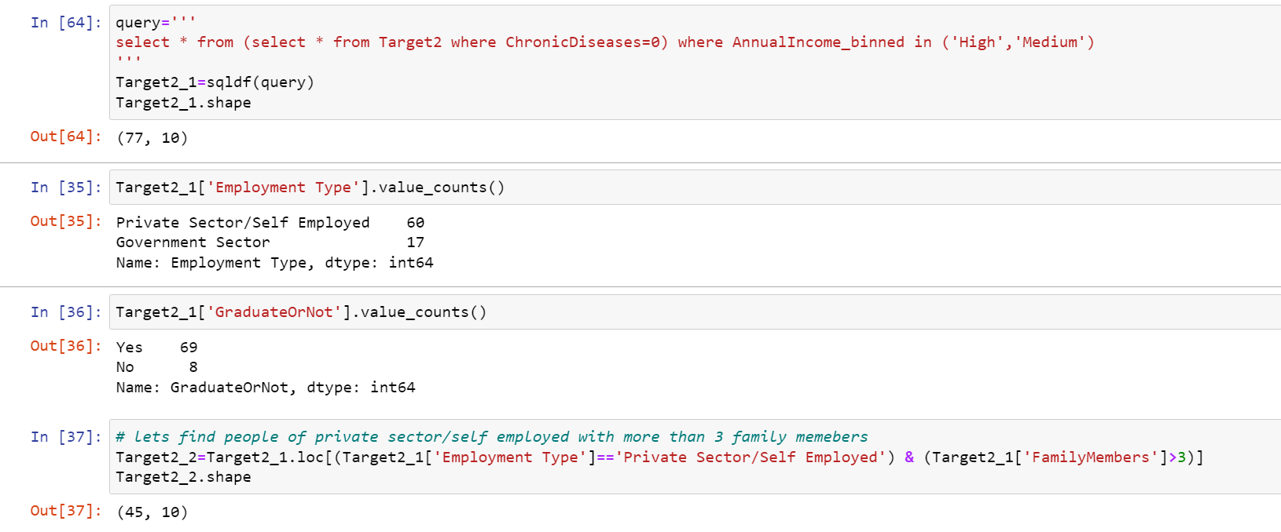
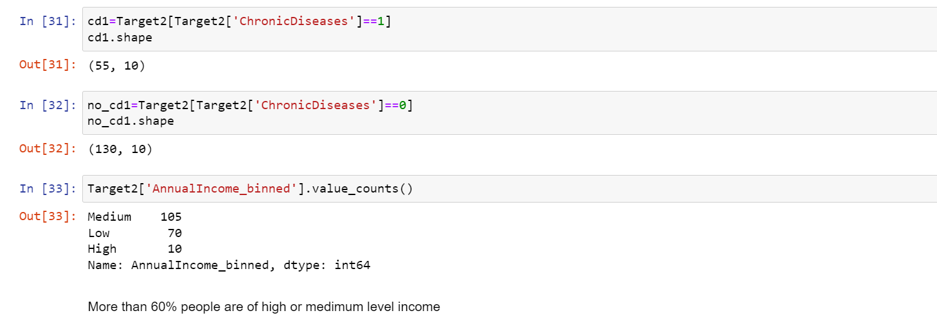
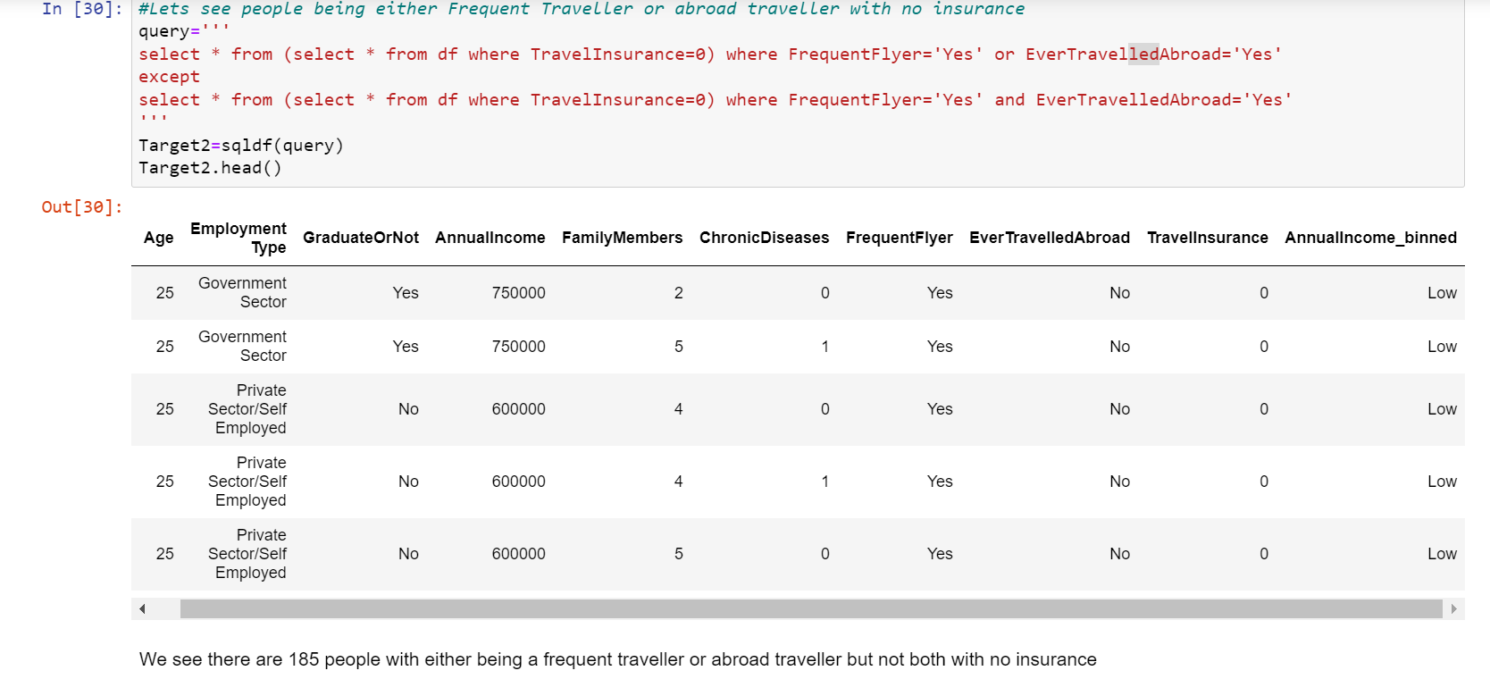
APPROACH:2 INSIGHTS

Slide 6
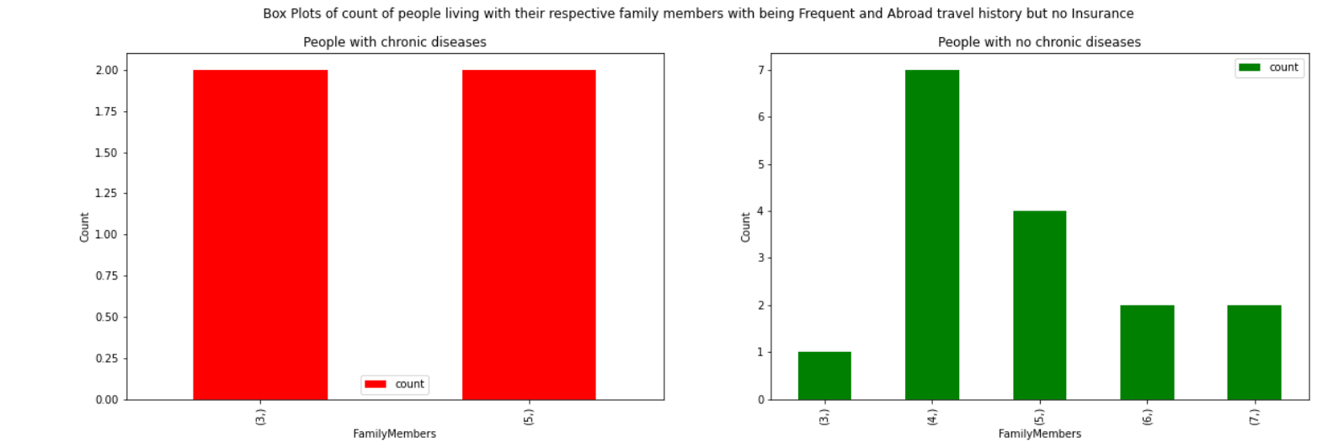
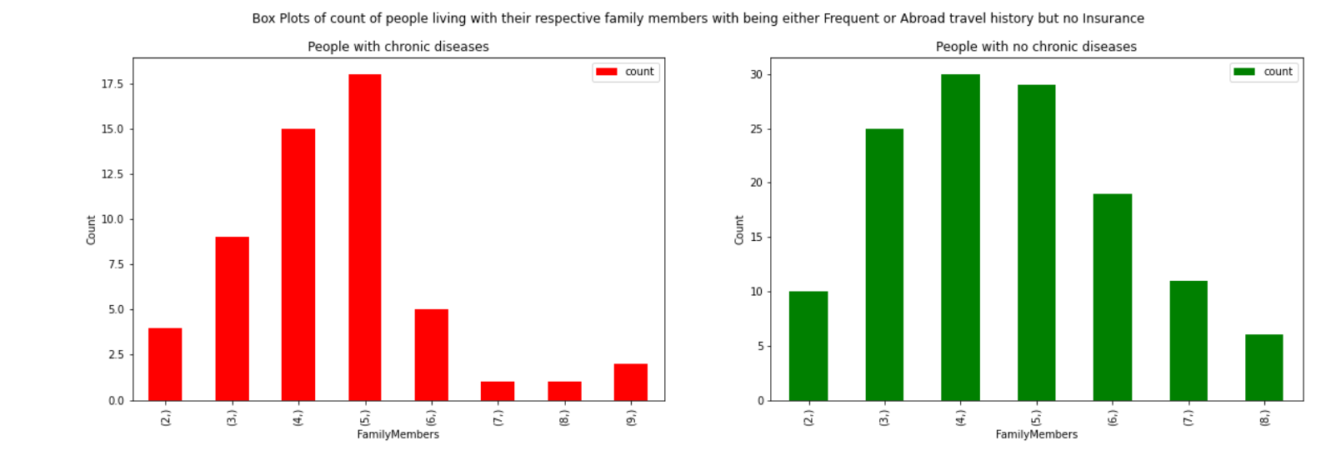
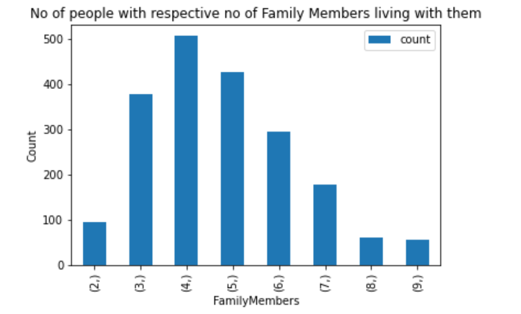
DATA VISUALIZATION

Slide 7
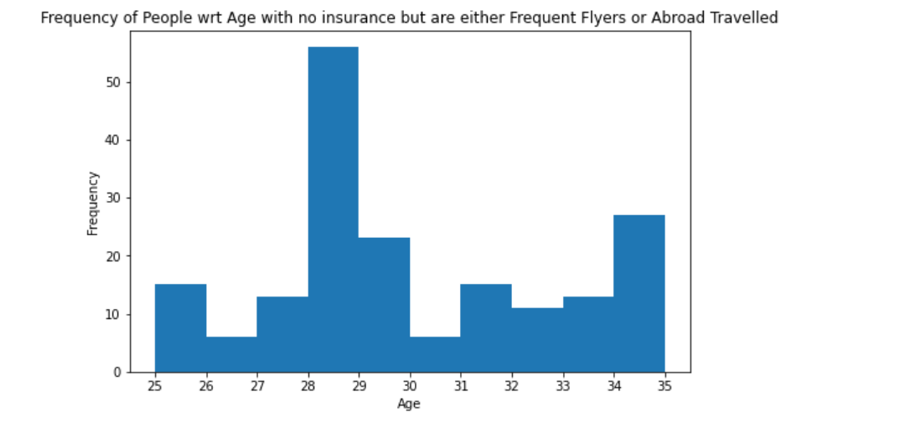
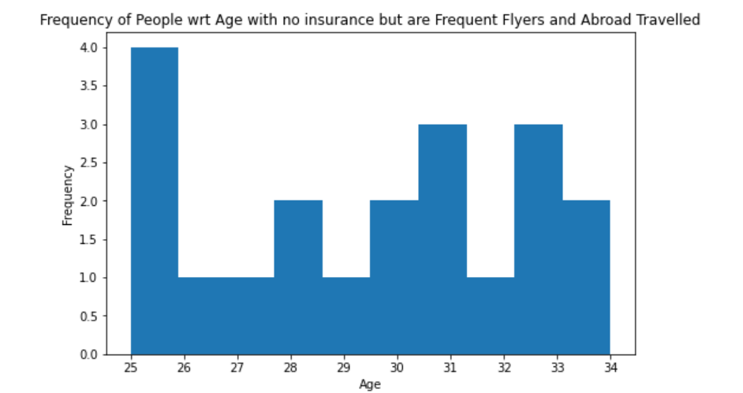

Slide 8
FINAL INSIGHTS
Among 1987 people there are 1037 people with no travel history and no insurance
People with good travel history-20 among which 10 are Highly incomed and 16 are not subjected to any diseases with age of 25-34 years
People being either Frequent/Abroad Travellers-185 among which 77 people have no diseases and are of High/Medium Income among which 56 people have more than 3 Family Members
Irrespective of travel history and with no chronic diseases have highest people with 4 Family Members
People who are either Frequent Flyers or Abroad Travelled are highly of age 28-29

